Slide 1

Brick Patterns on shells using geodesic coordinates
9647
Emil Adiels
Mats Ander, Chris J K Williams
ARCHITECTURE AND ENGINEERING RESEARCH GROUP

Slide 2
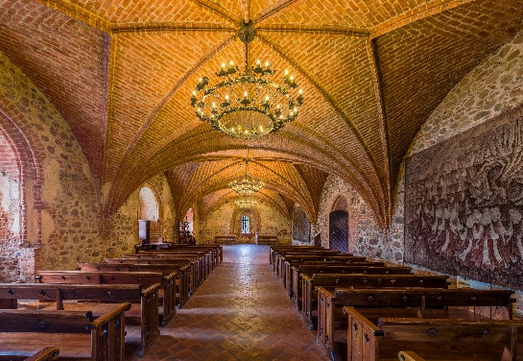
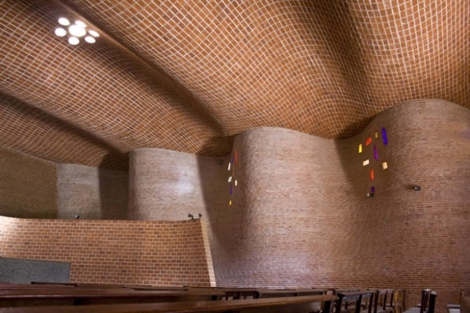
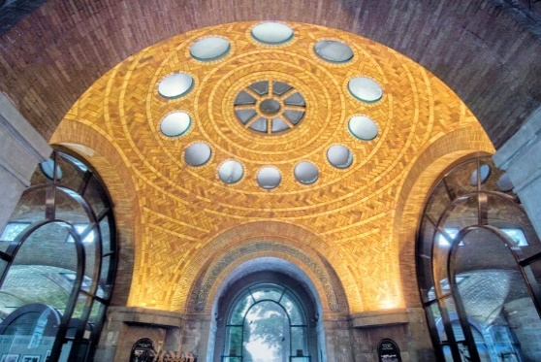
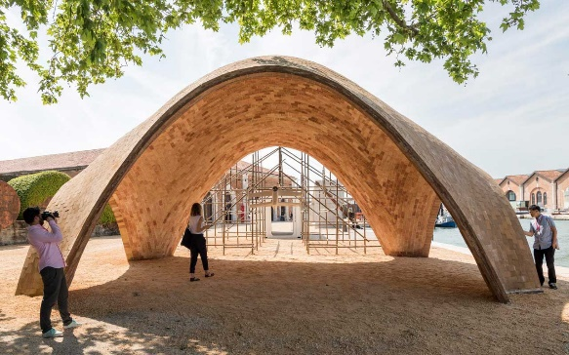
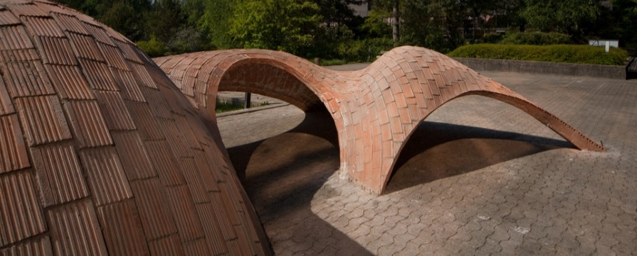
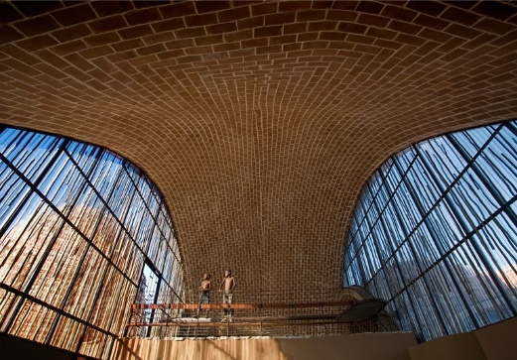
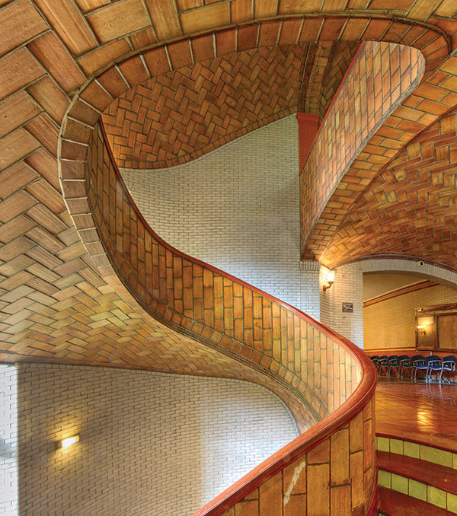
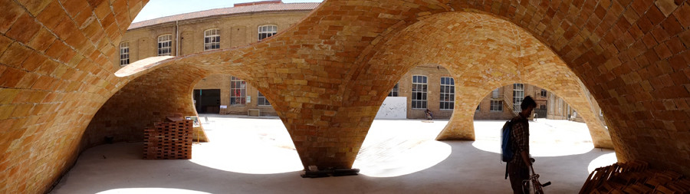
Trakai Island Castle, 14th – 20th century
The Guastavino Company, Elephant house at Bronx Zoo, 1908
Droneport prototype, Foster + Partners, Block research group, OBD Engineering, 2016.
Atlantida Church, Eladio Dieste,1952
Mapungubwe Interpretation Centre,P Rich, M Ramage, J Ochsendorf, P Block
Free-form Catalan Thin-tile vault,Block Research Group
The main staircase of Baker Hall at Carnegie Mellon University, Guastavino Company, 1914.
Bricktopia, International Collective Map13, 2013
Notes:
Thank you for the introduction. I am going talk about brick patterns on shells. And bricks shells can be seen as curved surfaces in space which consist of a singular building element, the brick, connected through mortar joints. And it is really important to me that the shape and the pattern fits well together.

Slide 3
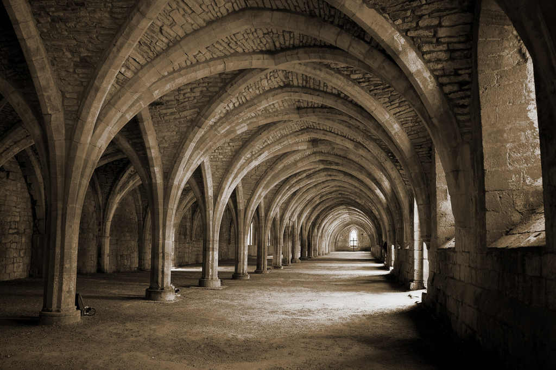
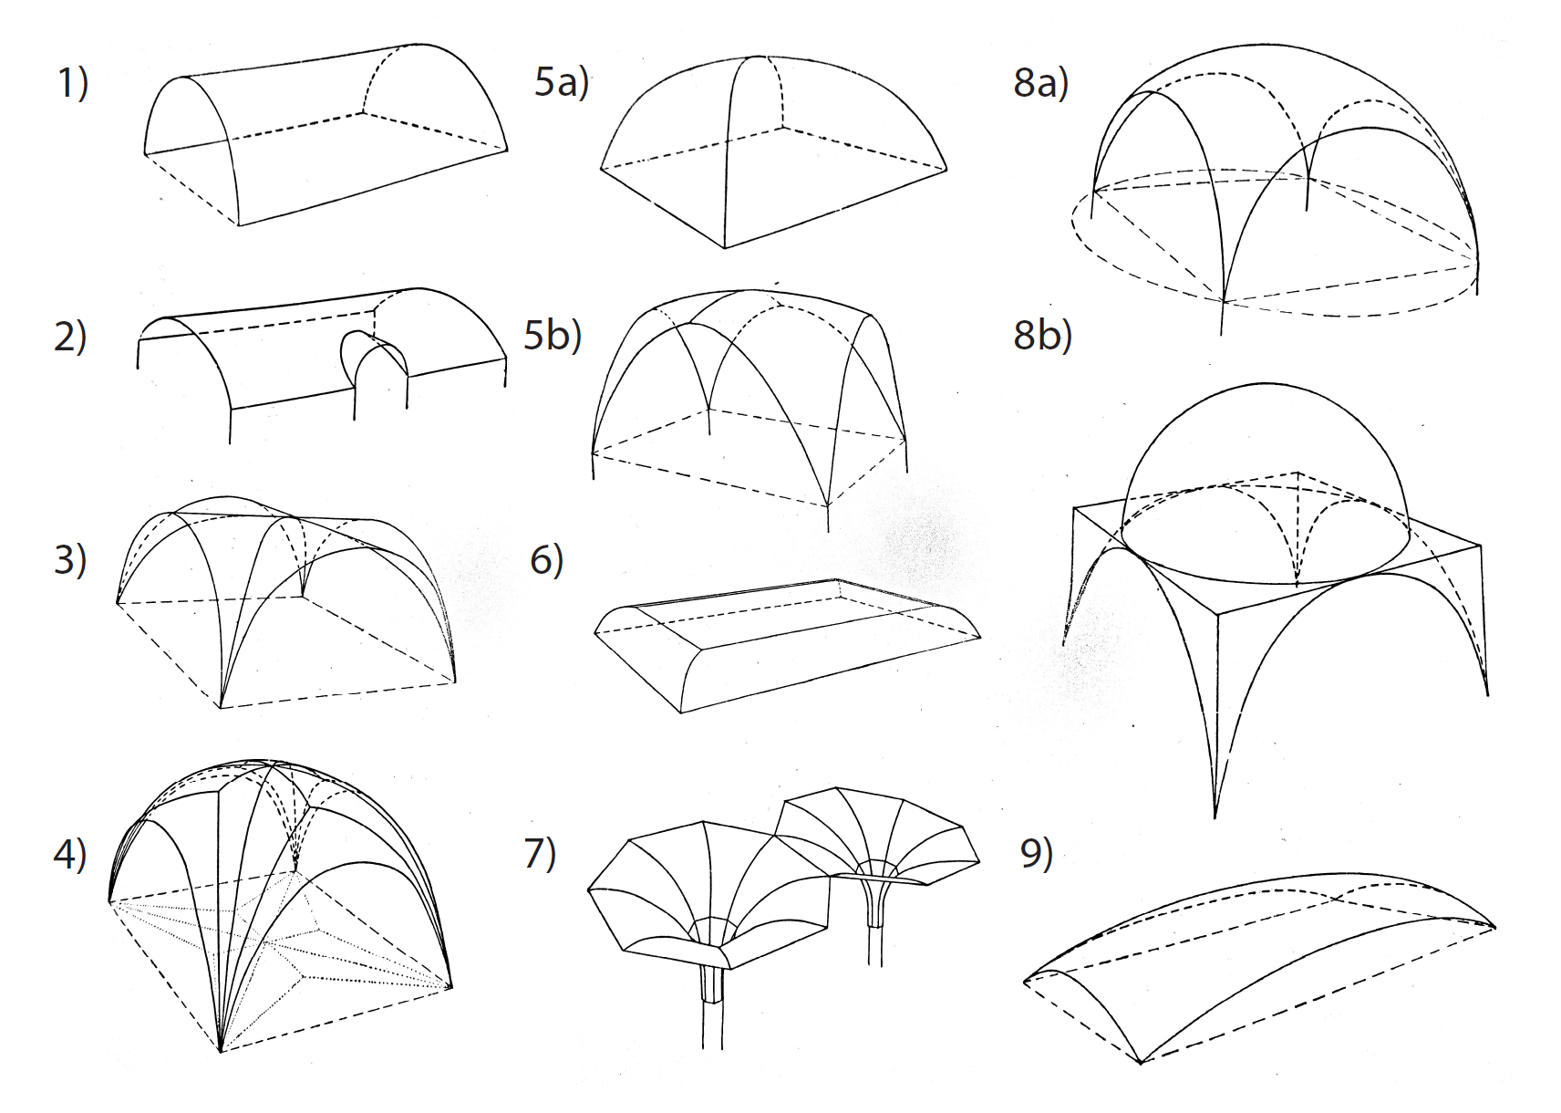
TRAKAI ISLAND CASTLE
GUASTAVINO
BLOCK RESEARCH GROUP
BLOCK RESEARCH GROUP
Cloister vault of Fountains Abbey, 12-13th century, North Yorkshire, England
Hantverketsbok. Mureri, Paulsson
Notes:
So historically they had a set of shapes that were based simple mathematical surfaces, which is very good from geometrical and production point of view, since they are relatively easy to analyse and construct.
Historically we used shapes that were constructed using simple mathematical surfaces that was easy to analyse and construct. This is very nice from geometrical and production point of view. But they are also limiting for us as designers. Since today we want our structures to fit into a context and they should be tailored for our needs.

Slide 4
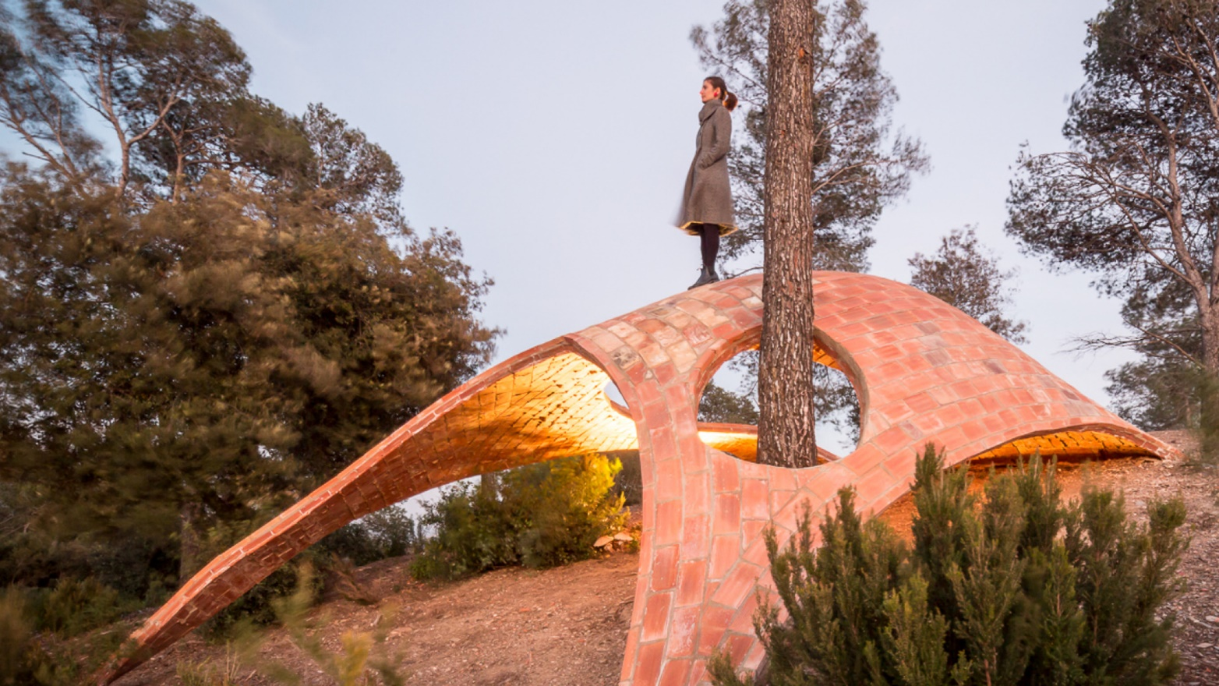
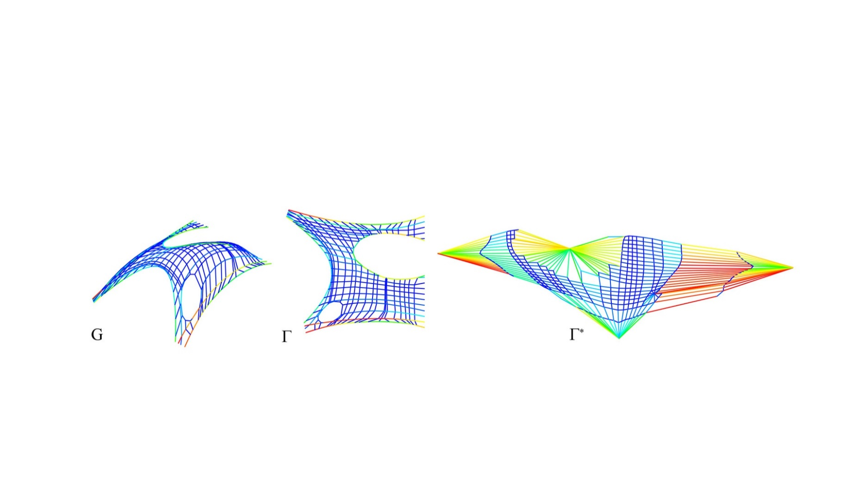
TRAKAI ISLAND CASTLE
GUASTAVINO
BLOCK RESEARCH GROUP
IaaC, in collaboration with Marta Domenech, David Lopez, Mariana Palumbo, and BLOCK Research Group
BLOCK RESEARCH GROUP
Thrust network analysis(Block, Ochsendorf)
Notes:
Now we want our structures to be tailored for our needs and it should fit into a context. And we have these great tools like RhinoVault using thrust network analysis which enables to derive complex masonry shells. Which is very cool but also becomes complicated making brick patterns.

Slide 5
Hantverketsbok. Mureri, Paulsson
Notes:
We cant use these old drawings of brick patterns and think we can apply it on our complex shells. So we need to find some rules that we can apply into a generic concept for more complex shells. What we would like is to take this more geometrical approach and merge it with the design philosophy and use modern tools.

Slide 6


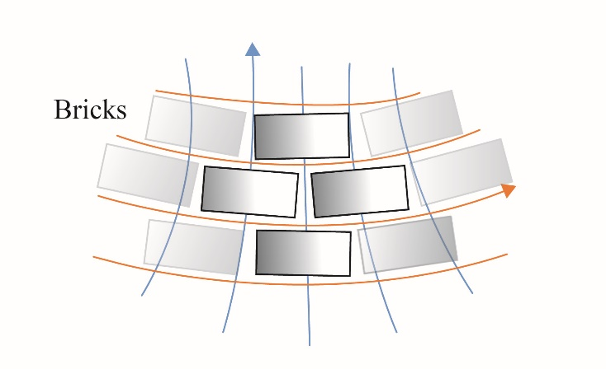
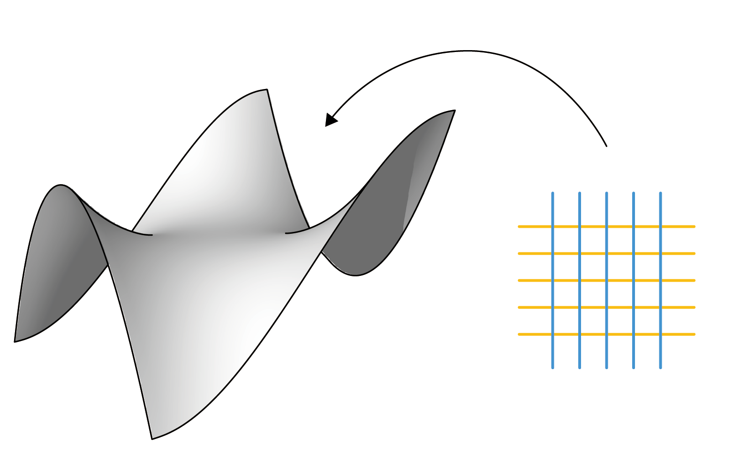
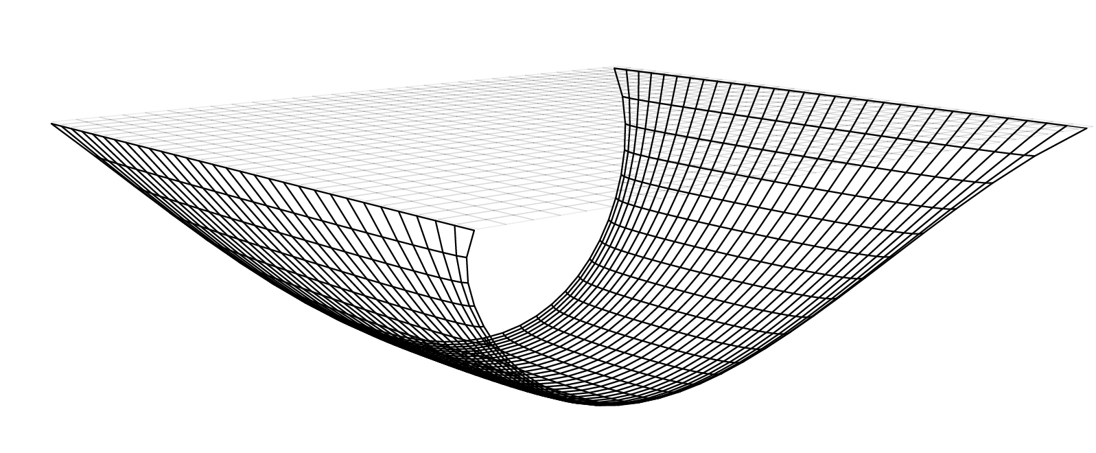
Decorating technique - geometrical mapping on known shell
Form finding - generate form and pattern simultaneously
Notes:
What we would like is to take this more geometrical approach and merge it with the integrity of us as designers and the available tools. From which we derive into a common geometrical concept that can be applied in two methods. One for decorating a pattern onto the shell and another where generate the form and pattern simultaneously through formfinding.

Slide 7
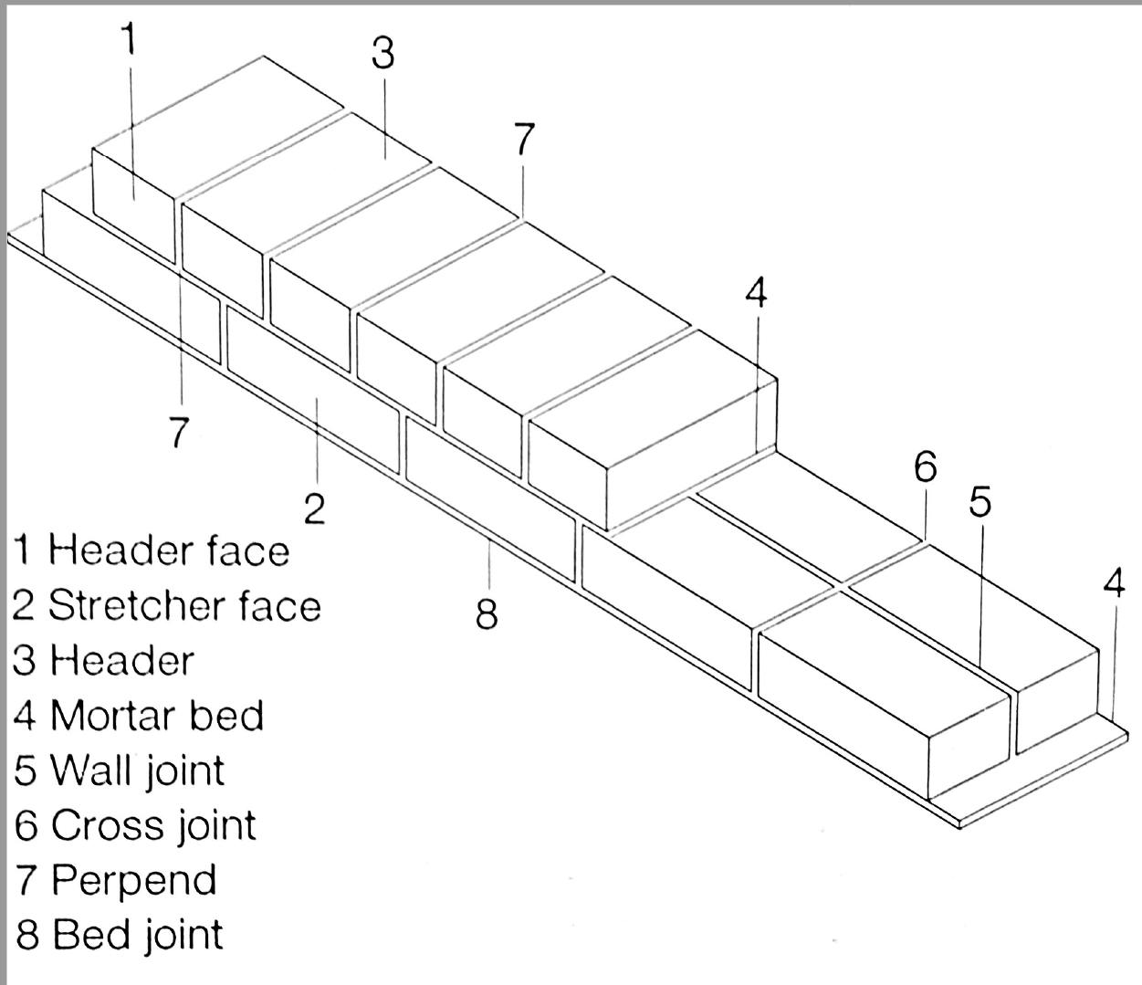

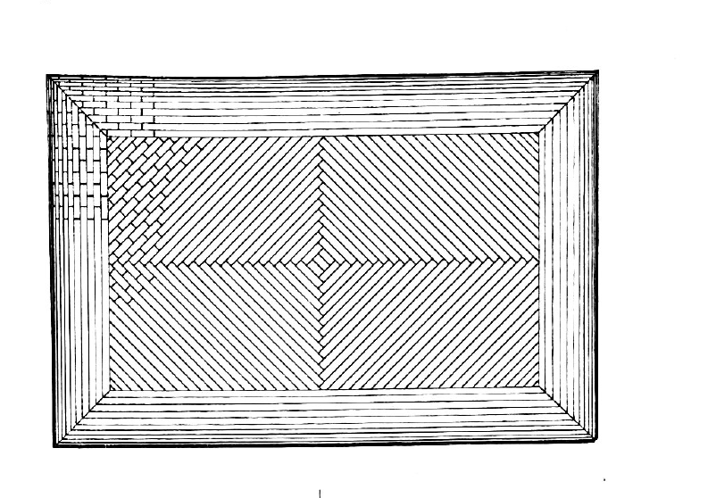
Bed joints
Bed joints
Bricks
Notes:
If we look at the drawing you can see that they empizise the bed joints, and they are not modelling every singke brick. Can we find a coordinate system on the surface that fulfills equal spacing between its coordinate curves to fit the bricks inside?

Slide 8
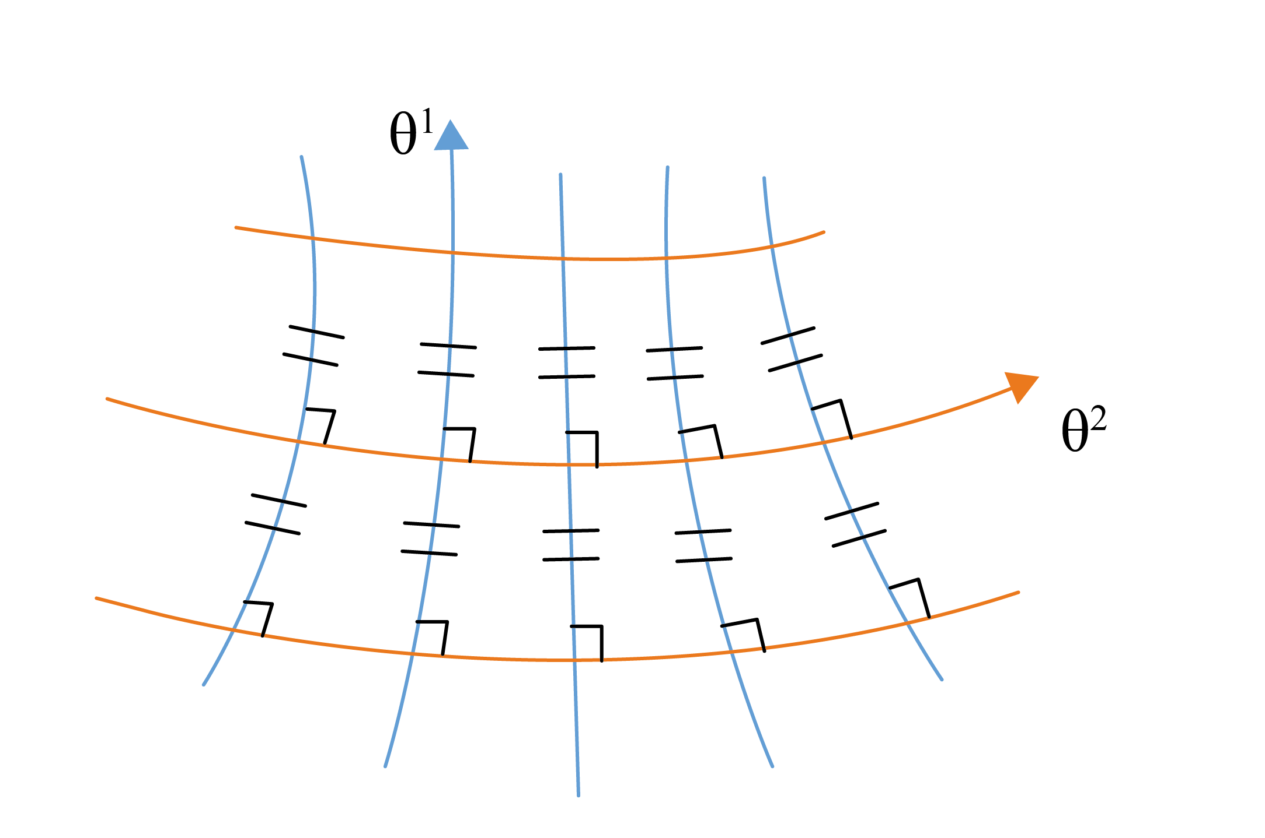
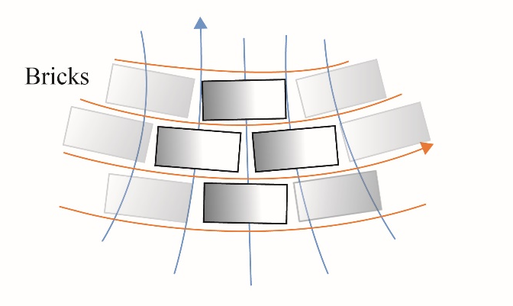
Geodesics
Orthogonal
Trajectories
Geodesic coordinates:
1. Constant spacing between the bed joints
2. Intersect at right angles
3. Geodesics
Any two implies the third
Lectures on Classical Differential Geometry, Struik
Notes:
There is such a system called geodesic coordinates, which is geodesics in one direction and its orthogonal trajectories in the other, intersecting at an right angle always equally spaced, which means we can fit bricks inbetween. So these become our bed joints. Satisfying two of these rules, the third comes for free

Slide 9
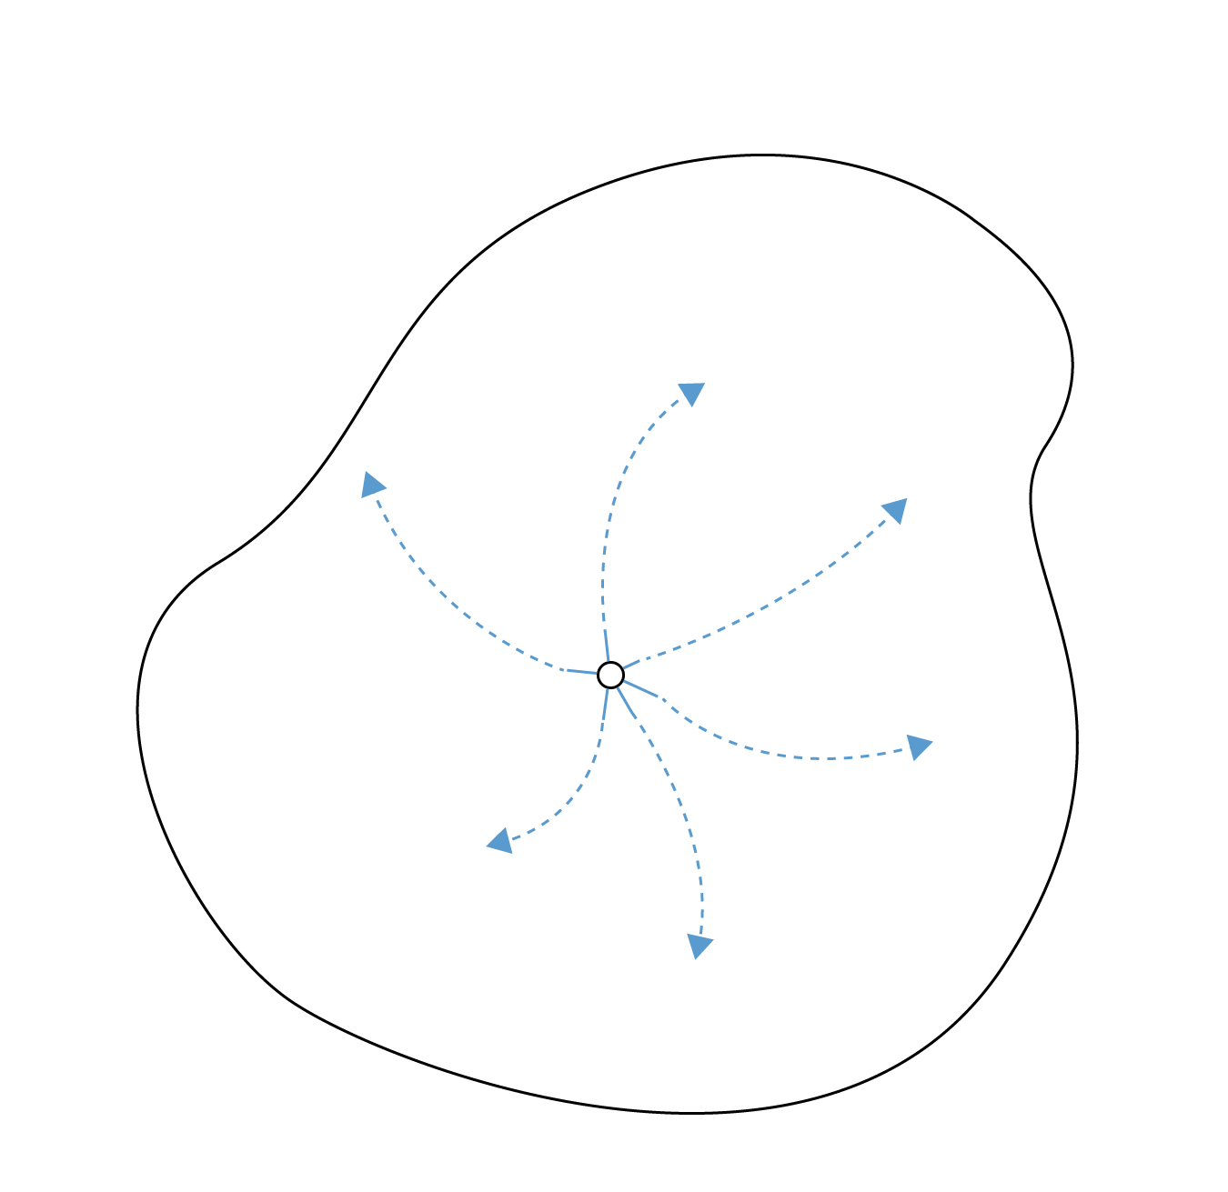
Specify starting point and direction
Architectural Geometry, H Pottmann, A Asperl, M Hofer, A Kilian
Notes:
Geodesics are curves on a surface with zero geodesic curvature, but can also be described as the shortest distance between two points on the surface. You can also construct a geodesic using a flat ribbon, and choose a starting point and direction on the surface and just try not wrinkle it, and you have a geodesic.
starting point and direction, like placing a flat ribbon onto the surface without wrinkling it.

Slide 10
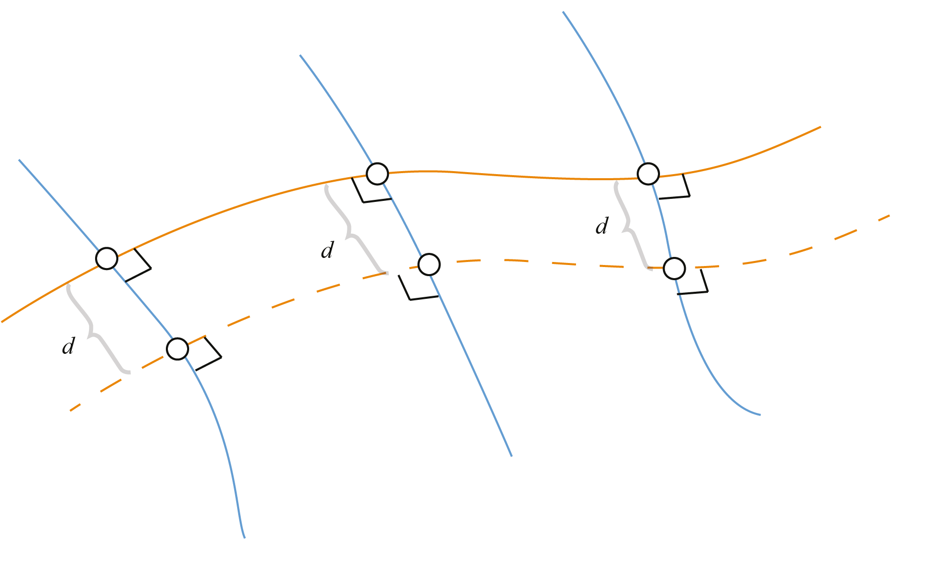
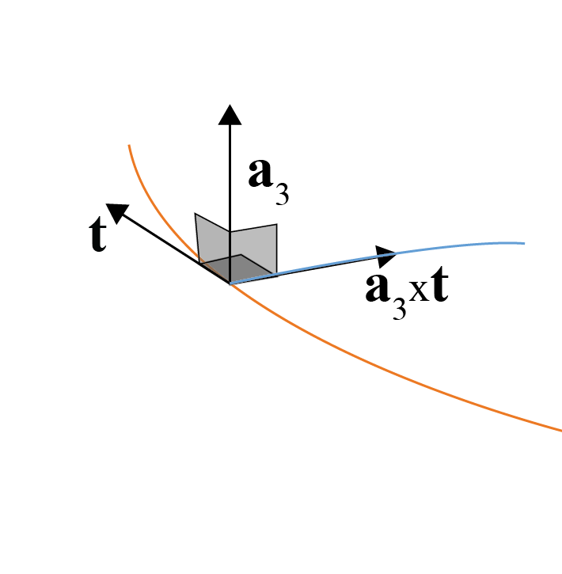
Notes:
So we use this fact and shot out a bunch geodesics orthogonal to an arbitrary curve, which become the first bed joint, and we measure and an equal length along the geodesics we get all our bed joints, since they automatically become orthogonal tajectores to the geodesics. Satysfying two rules, the third falls out for free.

Slide 11
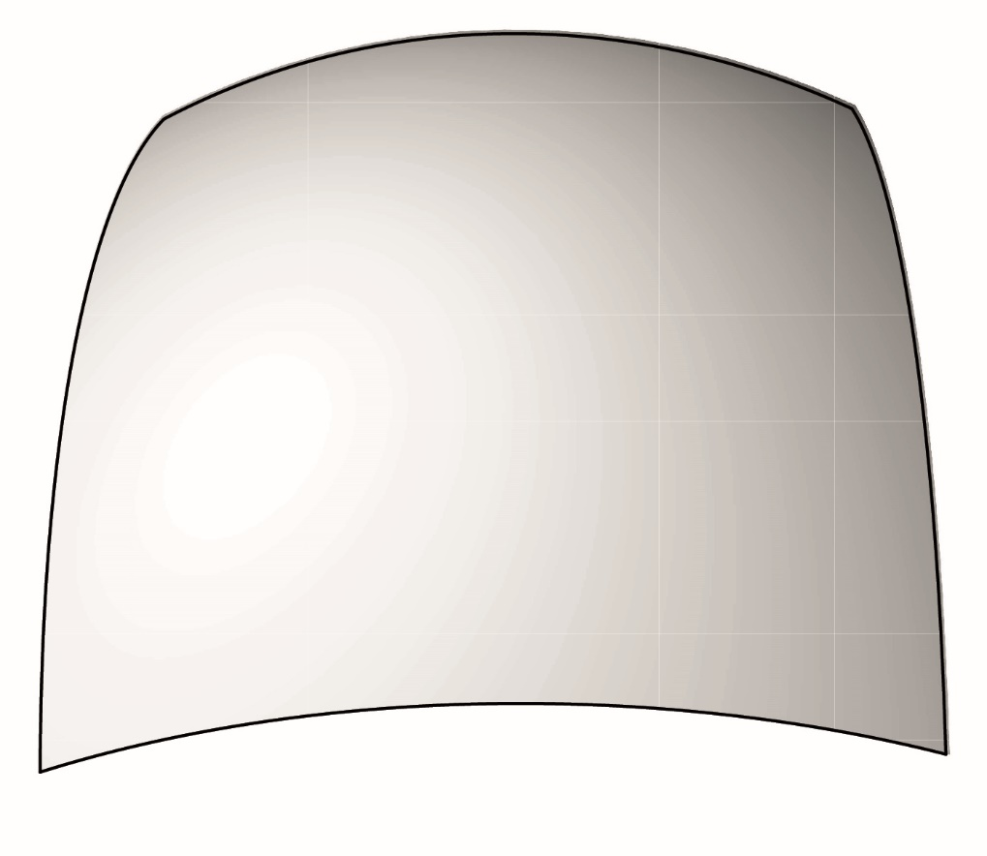
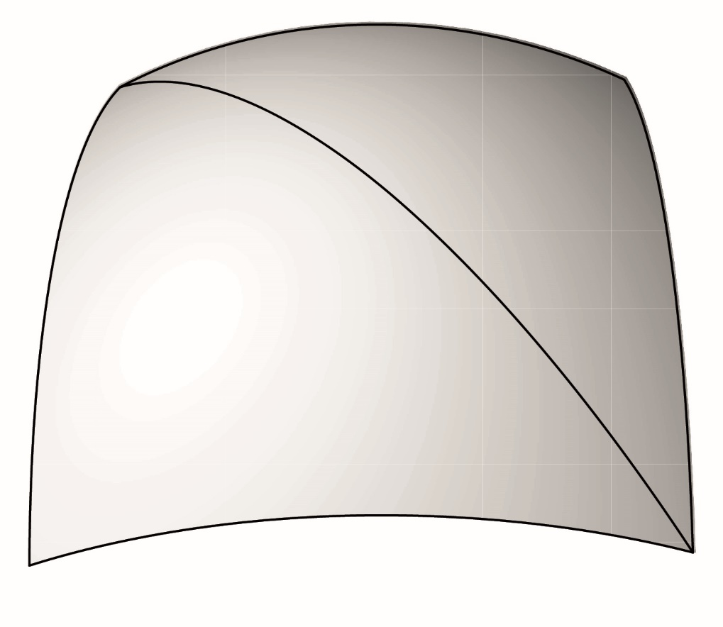
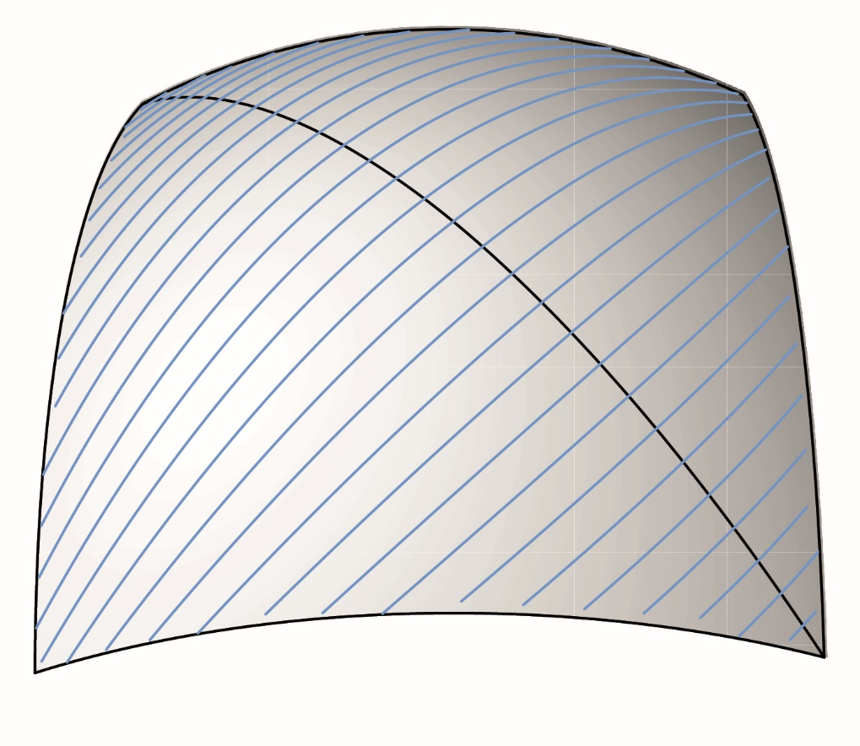
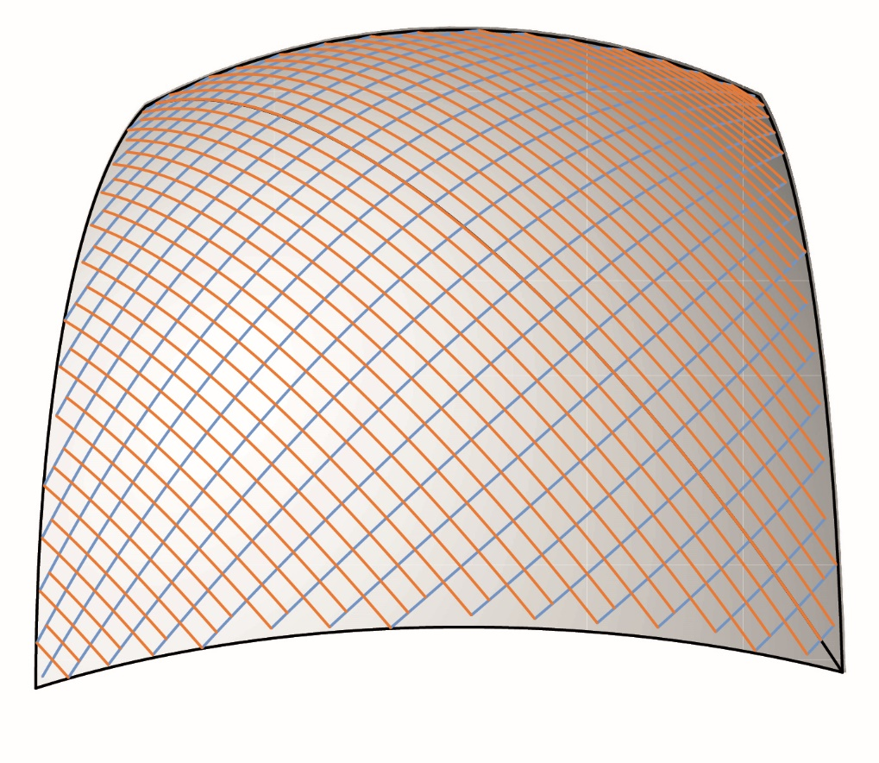
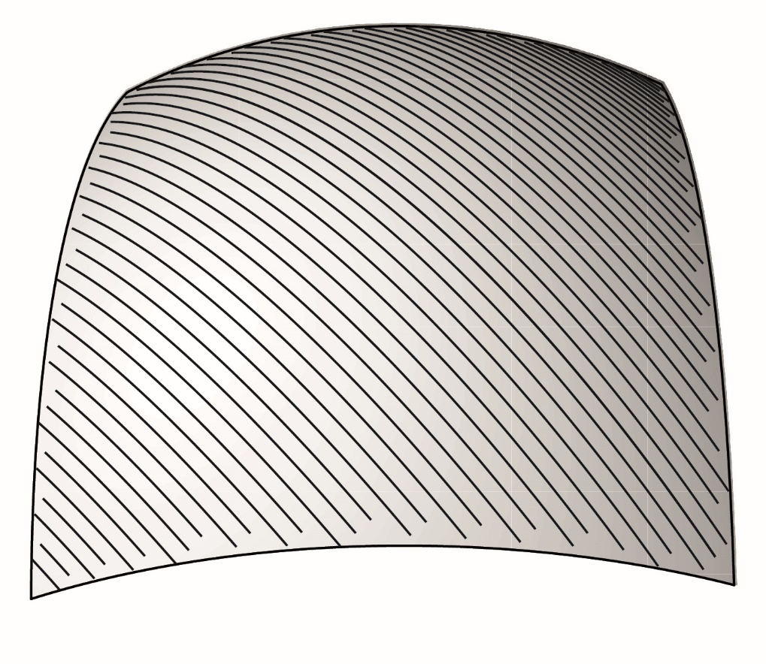
Generate the geodesics, orthogonal to starting curve
Which we represents as the bed joints
Choose the starting curve for your bed joints
Create the orthogonal trajectories by measuring along geodesics

Slide 12
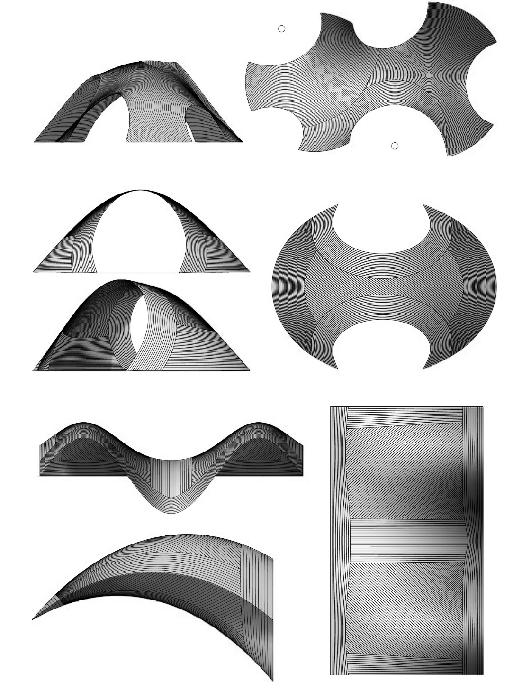
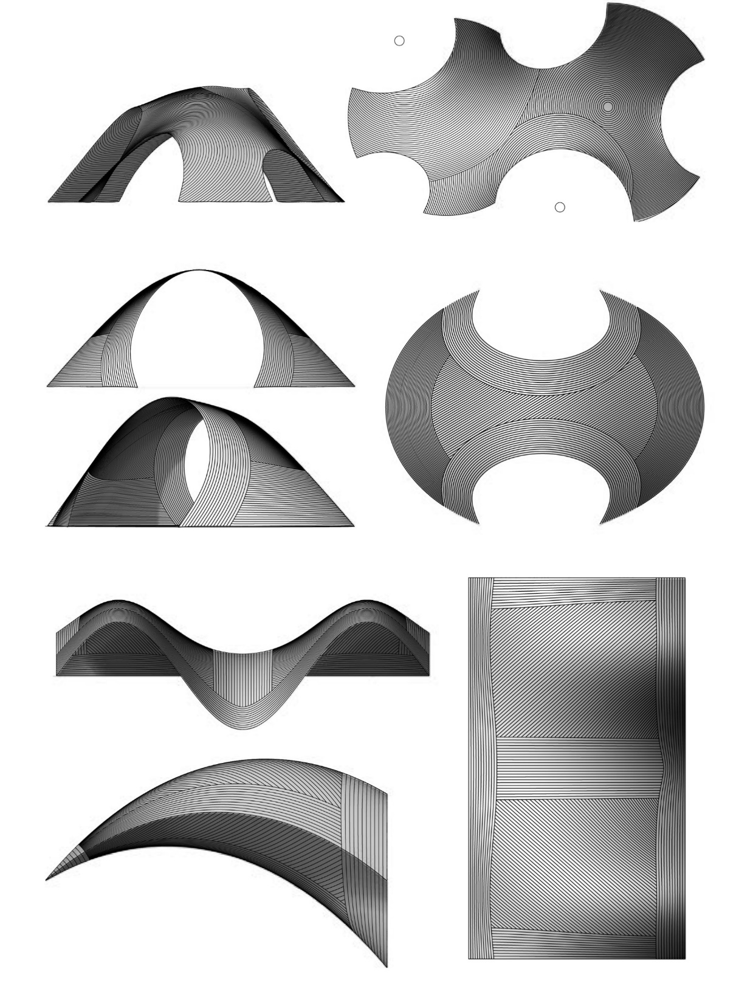
Decorating technique - geometrical mapping on known shell
Notes:
Here are some results where we applied patterns on some knowns surfaces. And since there are infinte geodesics on a surface, we can adapt the pattern based on edge conditions and taste. But the question can we generate both the form and patterns simultainiously.

Slide 13
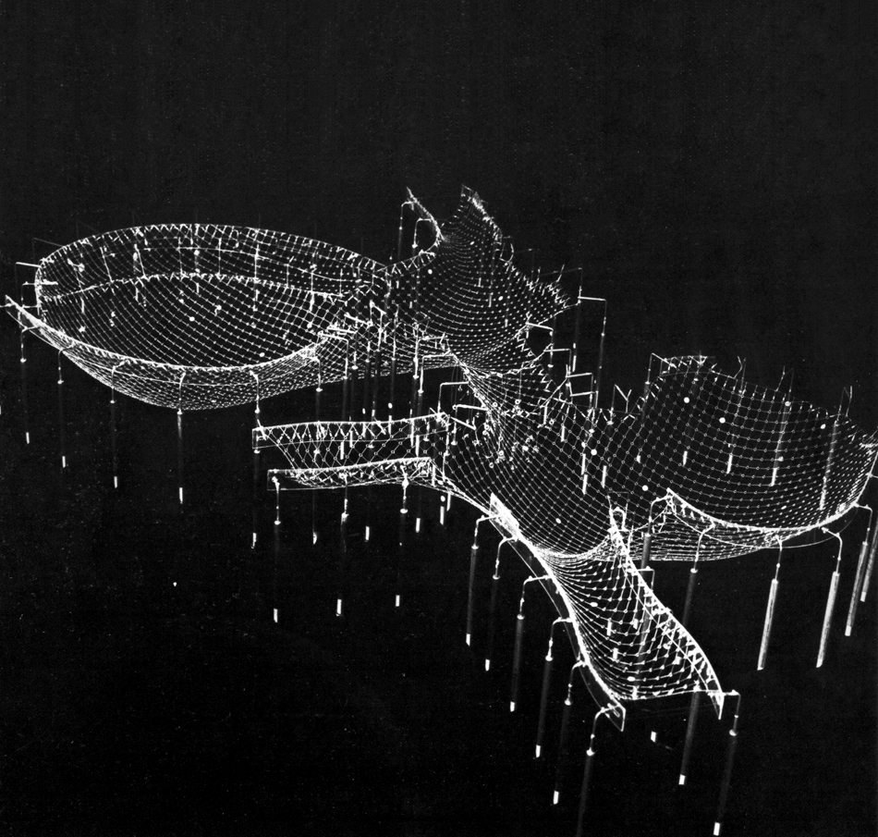
Mannheim Multihalle– Hanging Chain Model.
Notes:
Formfinding is very efficient way to design brick shells since we strive for a compression only state of stress in our structure. For the form finding of the Mannheim multihalle they implimted the equal mesh net, meaning equal length elements in the final mesh. So can we make our form finding procedure produce an geodesic coordinate net instead? Cause it really should not unless we do something about it.

Slide 14
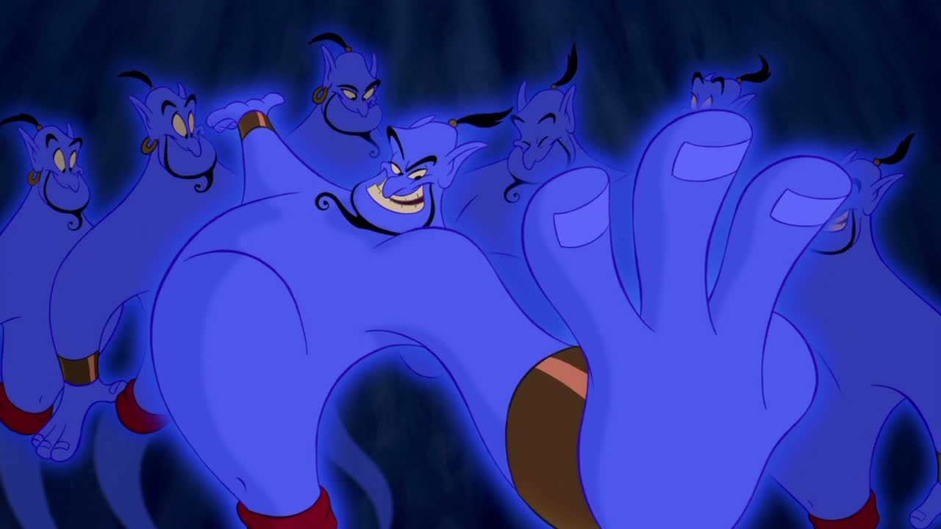
How can we make our form finding produce geodesic coordinates ?
9 Unknowns - 6 equations = 3 wishes
Notes:
So how can we make our form finding produce geodesic coordinates in equilibrium? It is possible due to that you have 3 wishes, and three wishes only. This is due to that you have 9 unkowns and 6 equations, meaning three wishes. And I should tell you why!

Slide 15
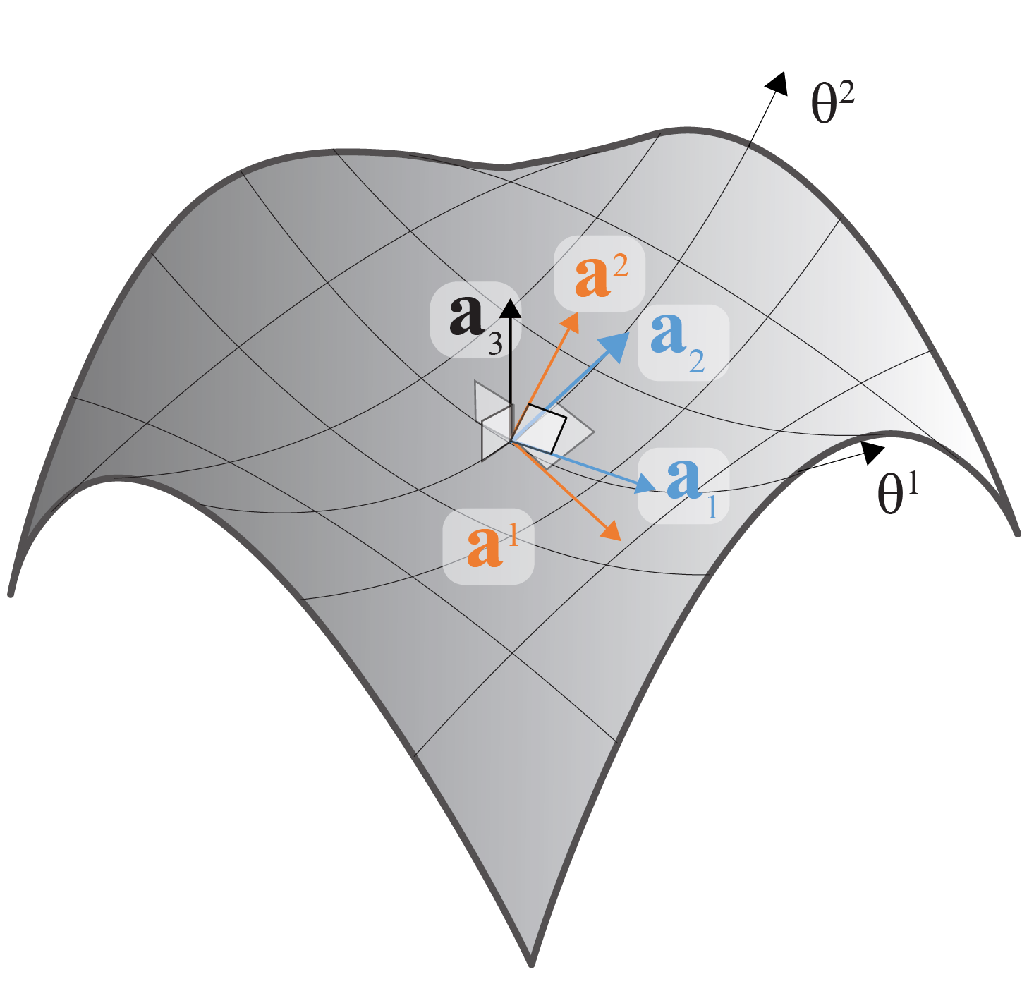
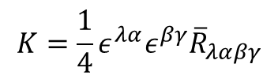
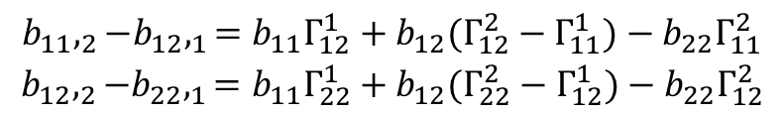
Curvilinear parametrization of a surface
6 surface components
Gauss-Codazzi Equations
$$\begin{matrix}b_{11},_{2}−b_{12},_{1}=b_{11}Γ_{12}^{1}+b_{12}(Γ_{12}^{2}−Γ_{11}^{1})−b_{22}Γ_{11}^{2} \\ b_{12},_{2}−b_{22},_{1}=b_{11}Γ_{22}^{1}+b_{12}(Γ_{22}^{2}−Γ_{12}^{1})−b_{22}Γ_{12}^{2}\end{matrix}$$
$$K=\frac{1}{4}ε^{λα}ε^{βγ}{\overline{R}}_{λαβγ}$$
Theoretical Elasticity – A E Green, W Zerna

Slide 16
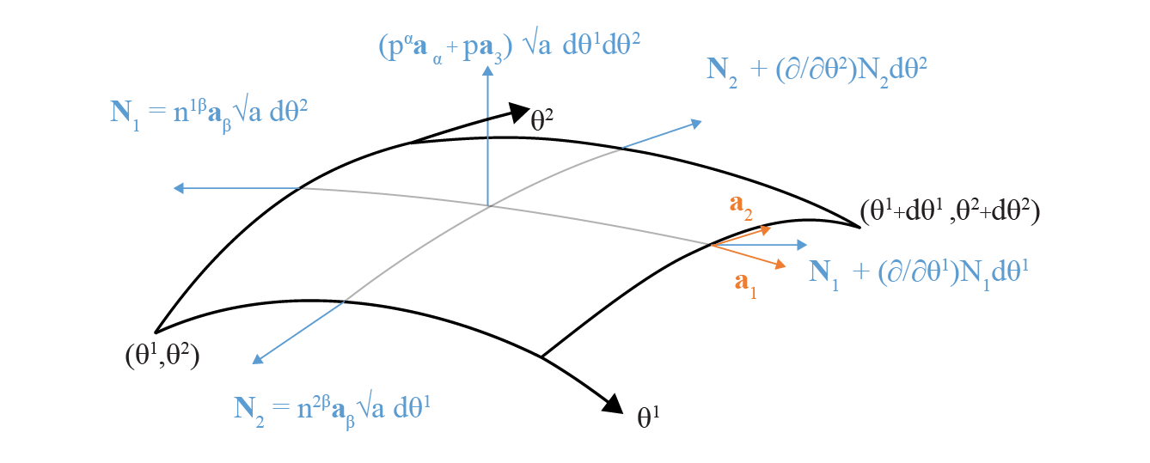
Curvilinear parametrization of a surface
6 surface components
3 surface stress components
Equilibrium equations for
a membrane shell(3 equations)
Gauss-Codazzi Equations
$$\begin{matrix}b_{11},_{2}−b_{12},_{1}=b_{11}Γ_{12}^{1}+b_{12}(Γ_{12}^{2}−Γ_{11}^{1})−b_{22}Γ_{11}^{2} \\ b_{12},_{2}−b_{22},_{1}=b_{11}Γ_{22}^{1}+b_{12}(Γ_{22}^{2}−Γ_{12}^{1})−b_{22}Γ_{12}^{2}\end{matrix}$$
$$K=\frac{1}{4}ε^{λα}ε^{βγ}{\overline{R}}_{λαβγ}$$
Theoretical Elasticity – A E Green, W Zerna

Slide 17
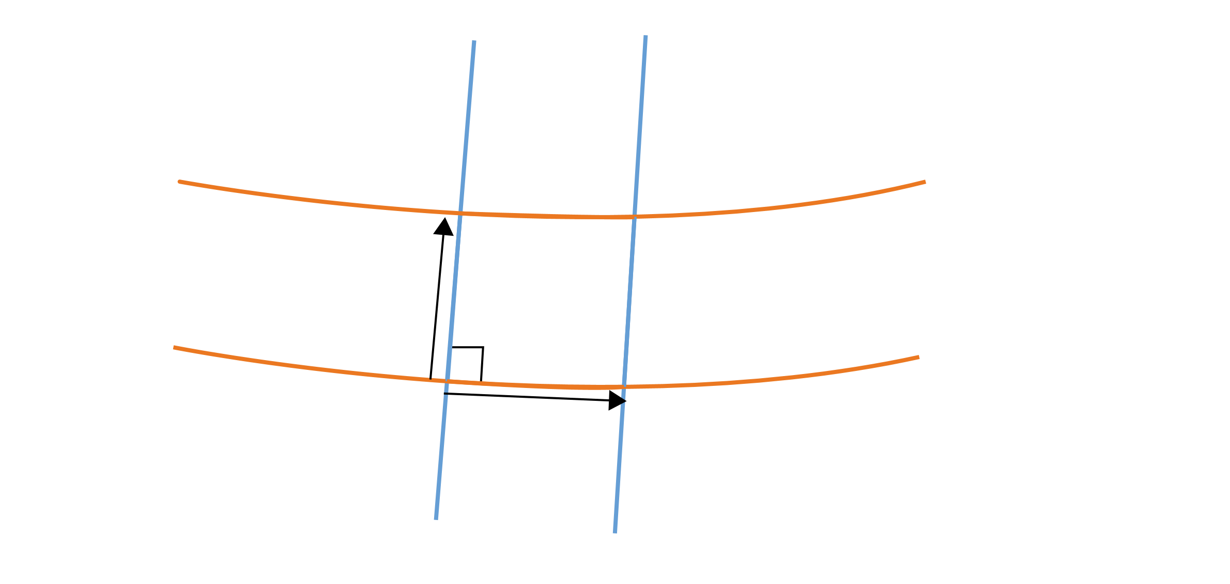
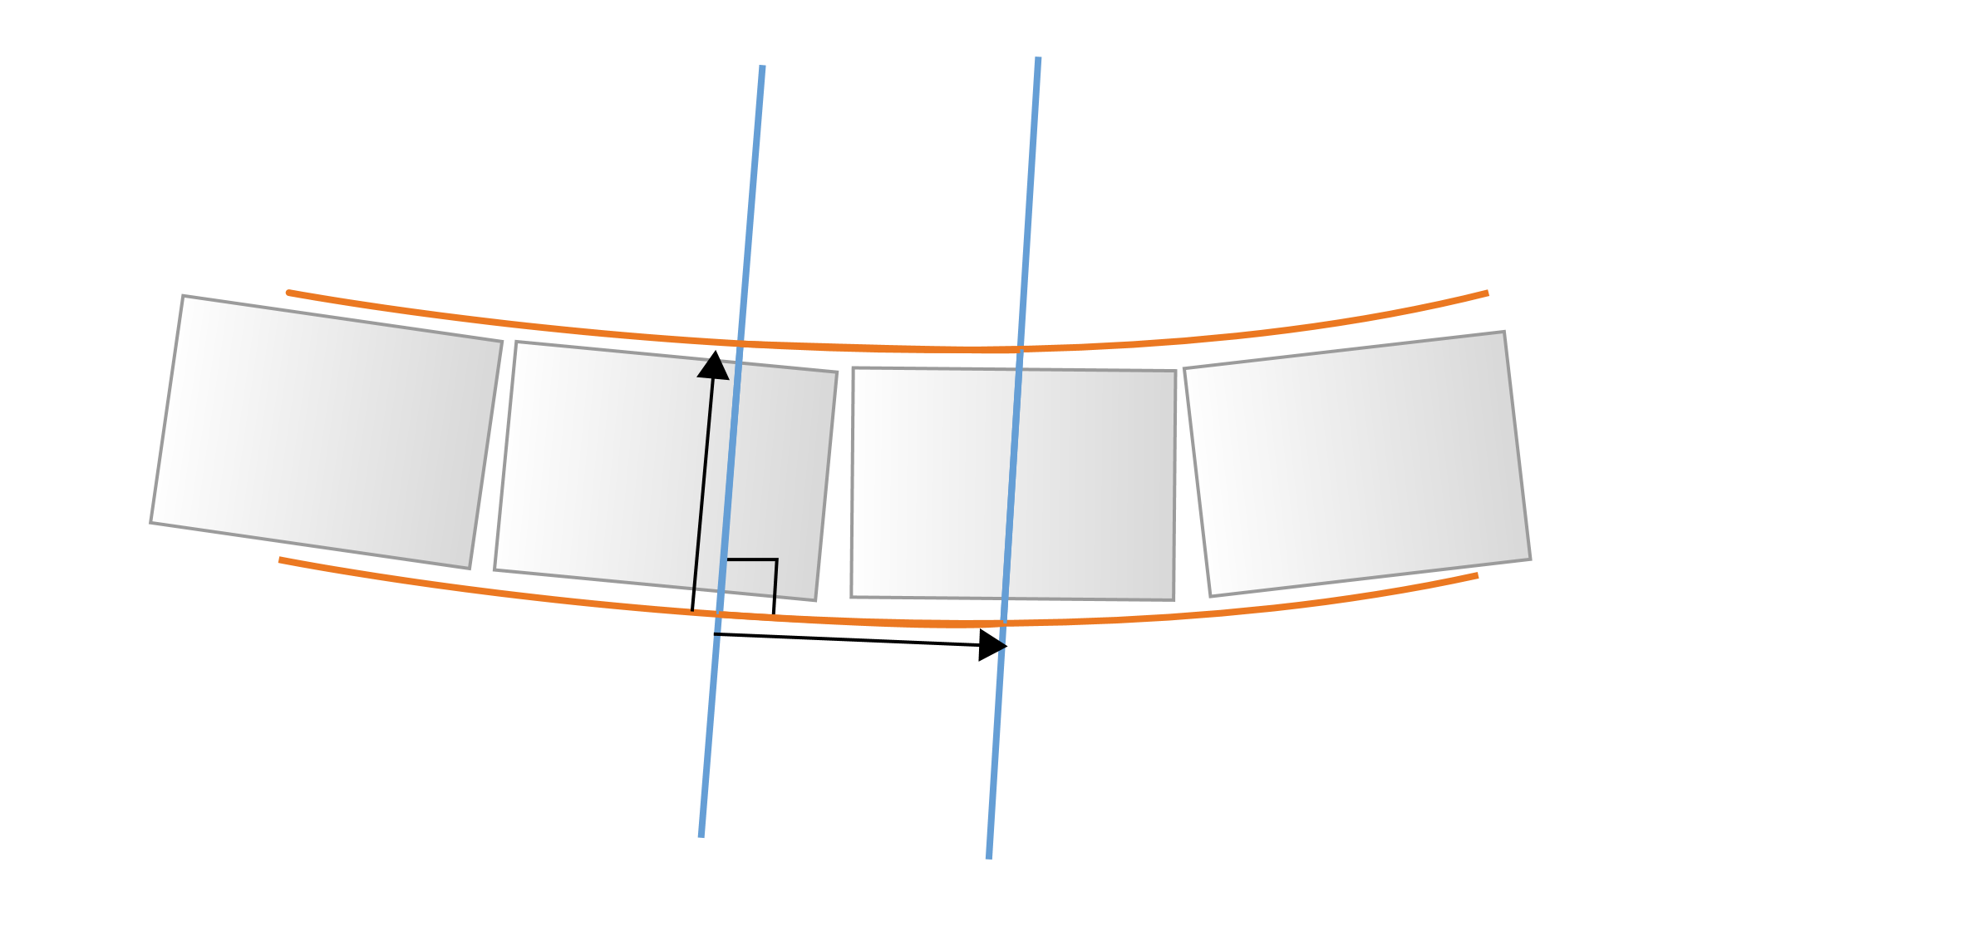
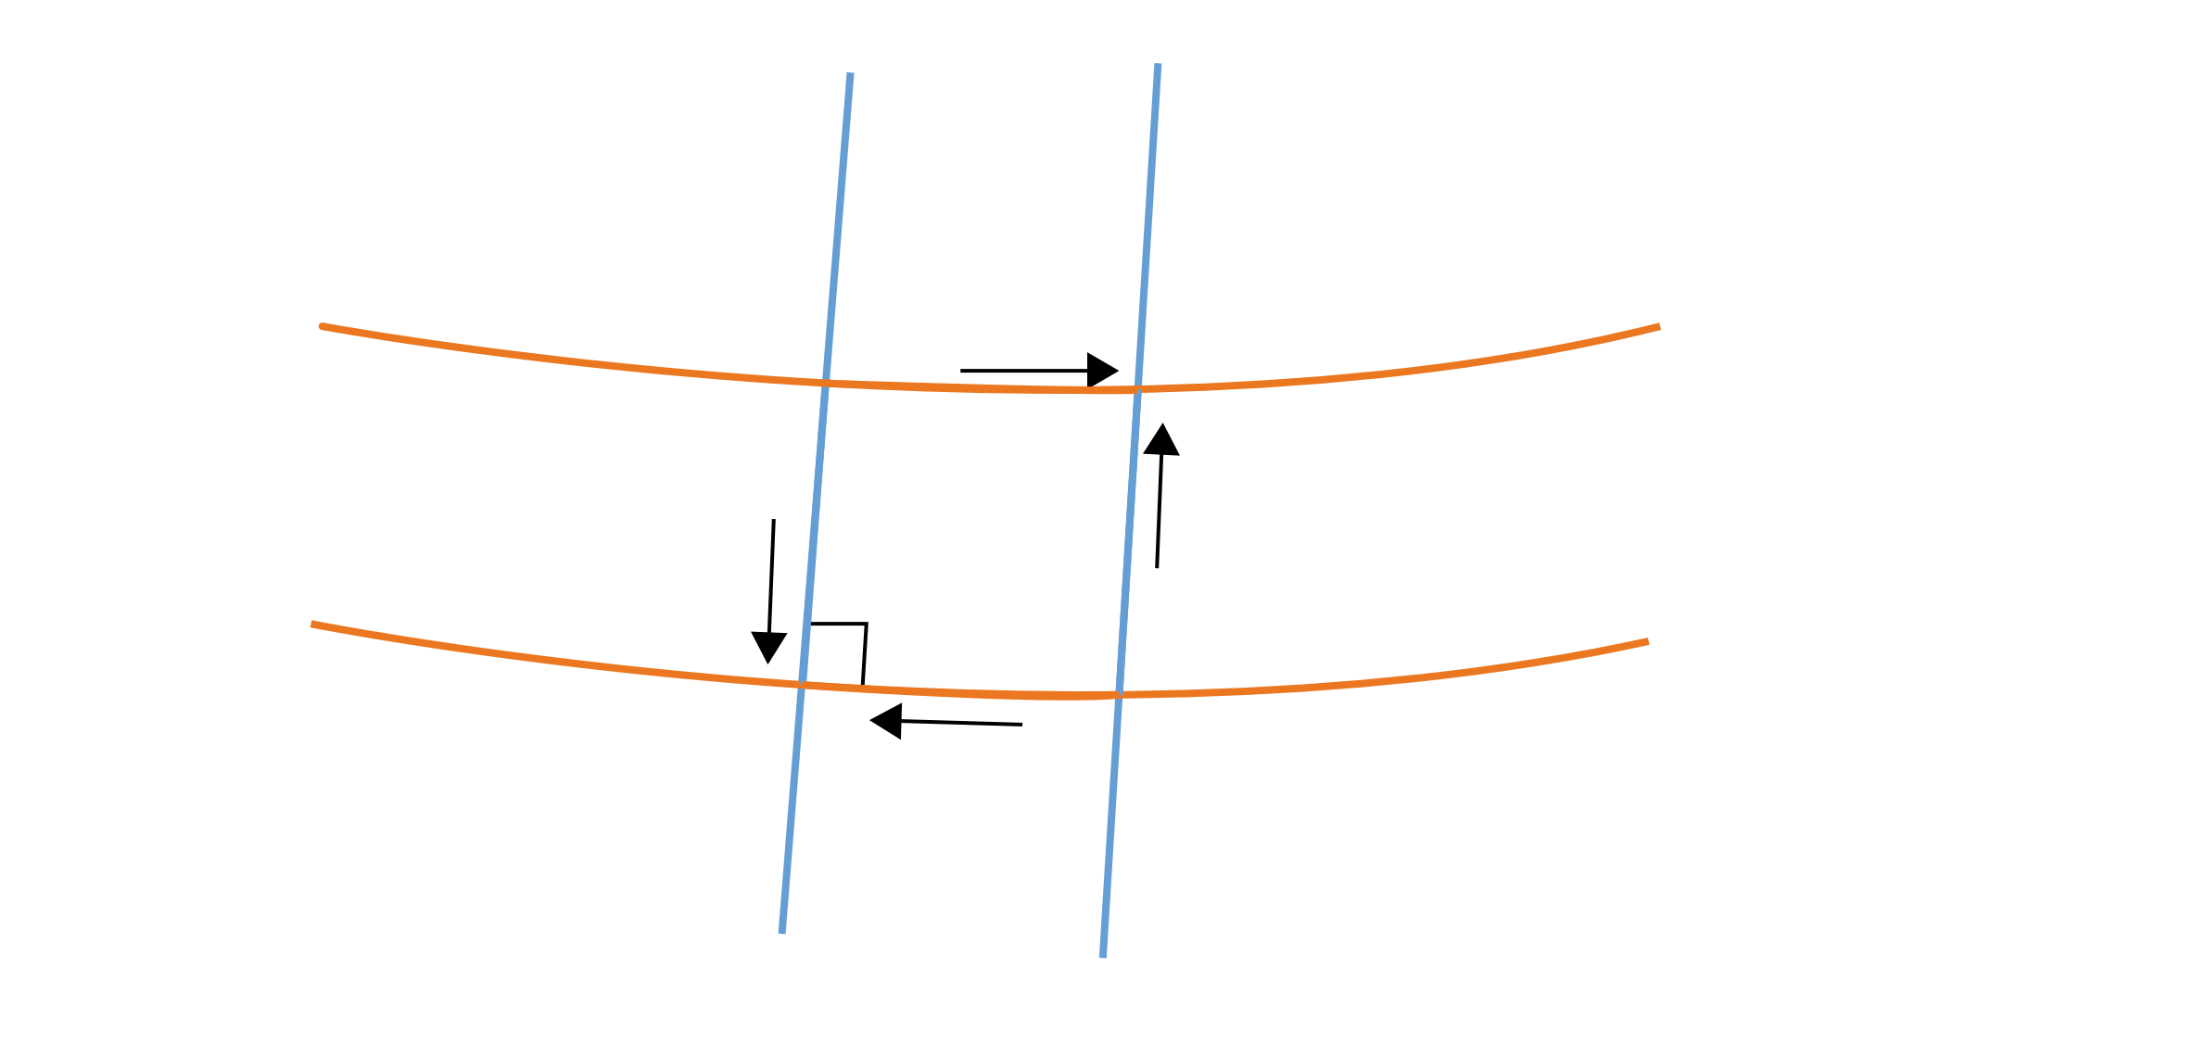

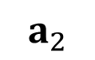
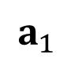
$$a_{1}$$
$$a_{2}$$
Notes:
I wish a11 to be l^2, for the constant spacing, a12 to be zero for right angle. These are the necessary geometrical constaints for geodesics coordinates. And then we have one more wish, that is to zero shear stresses along the bed joints.

Slide 18
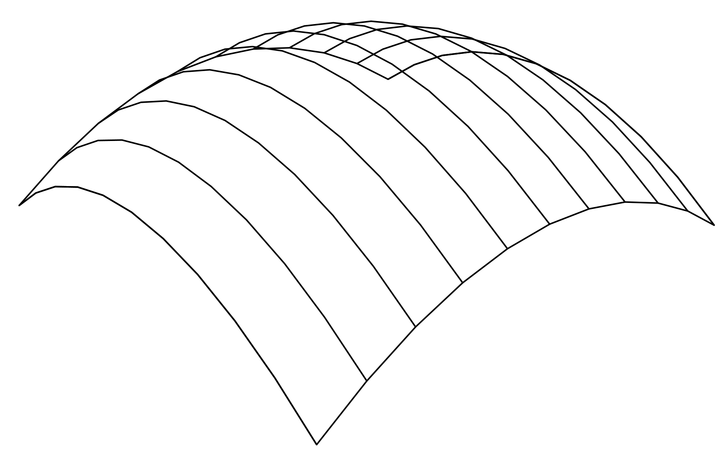
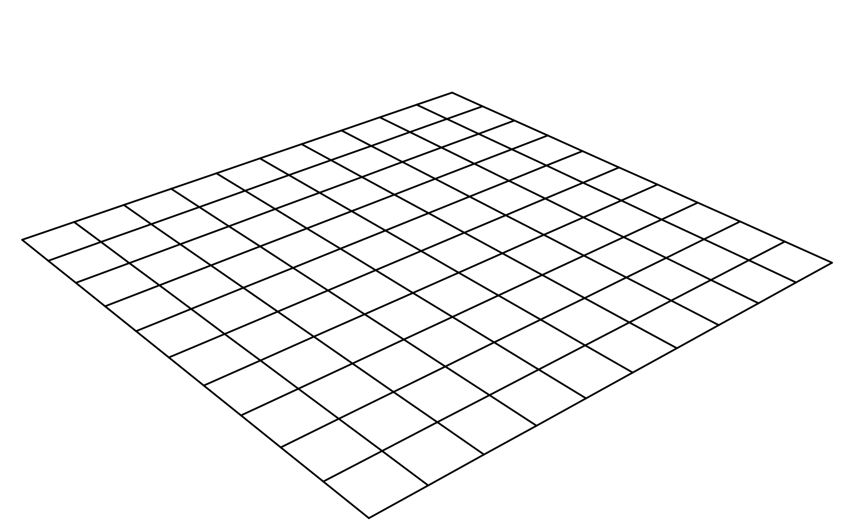
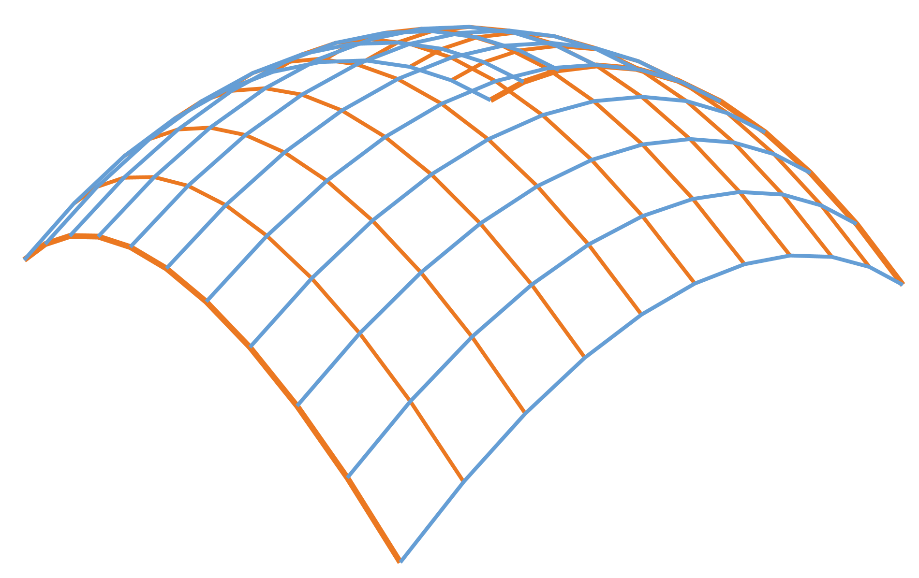
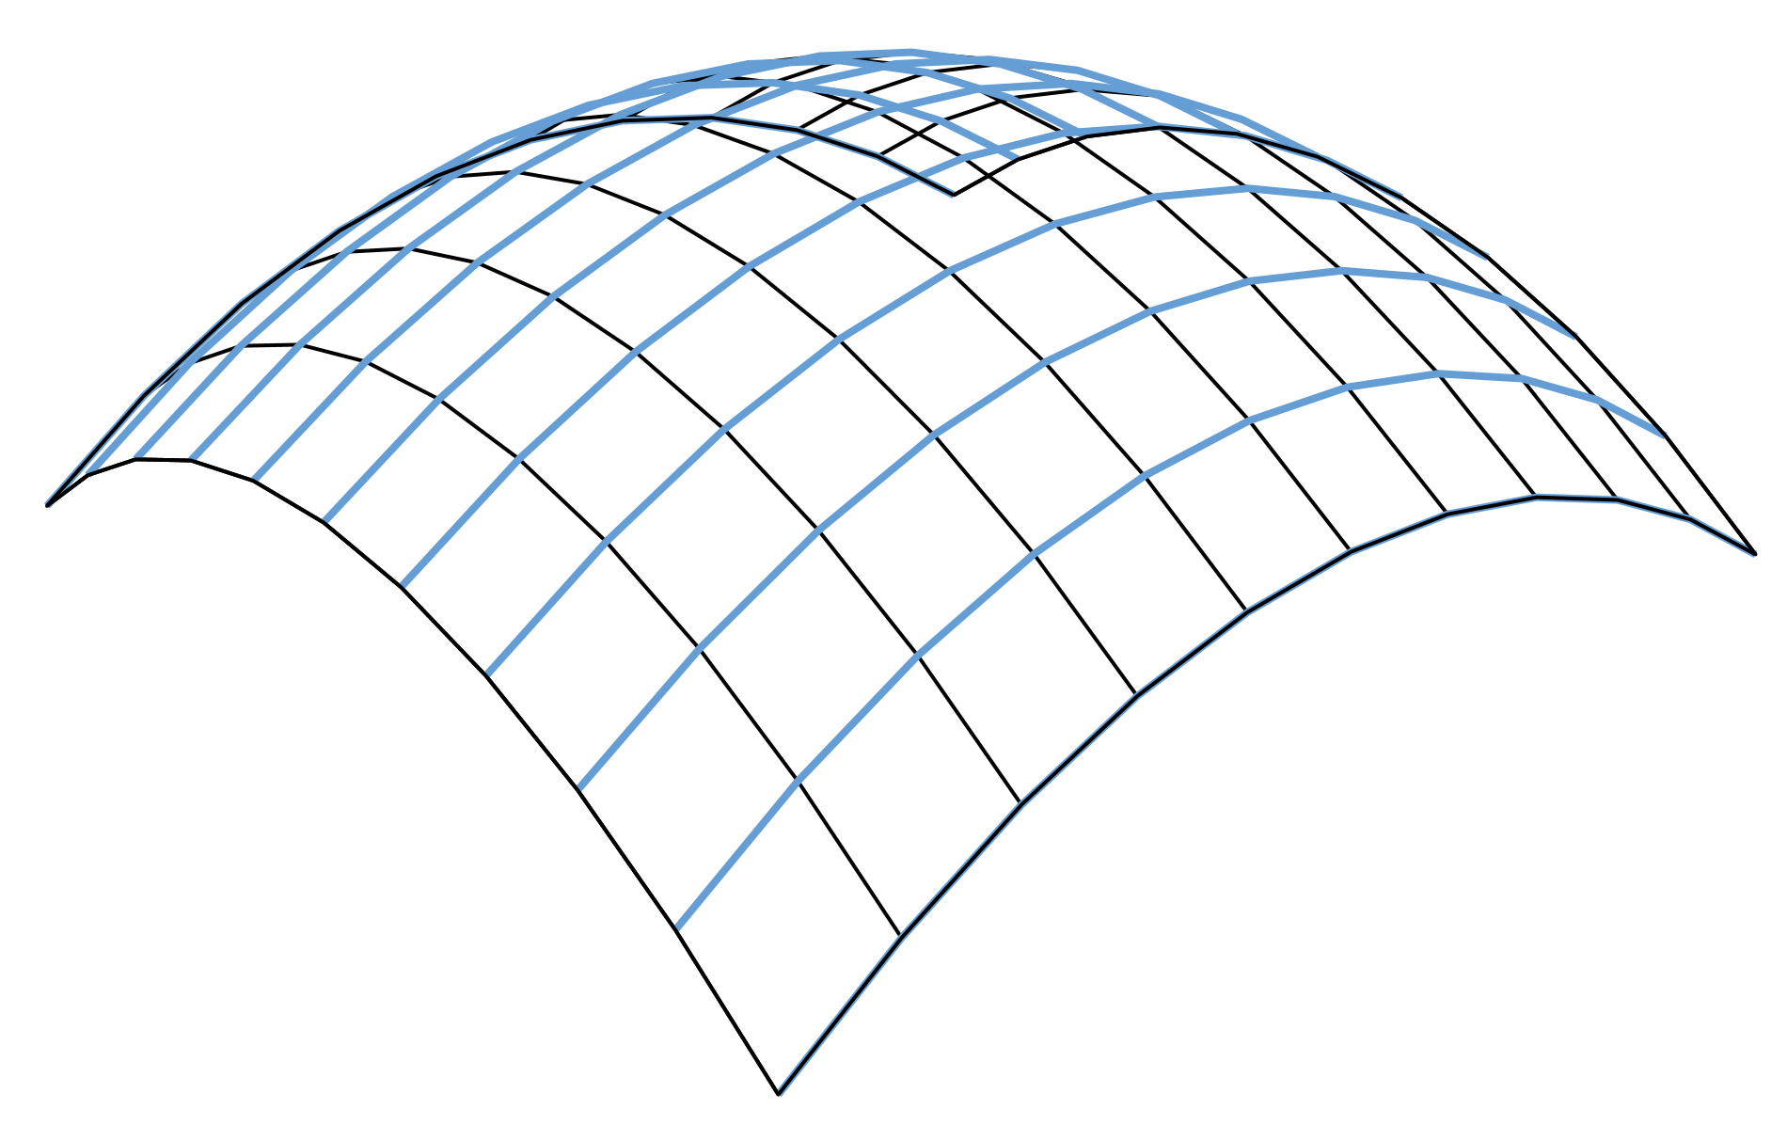
Apply positive gravity load
Geodesics
Bed joints
Constant spacing
Geodesic coordinate net in compression
Notes:
So here is the idea of the form finding, we apply gravity and during the process we first strive to generate geodesics and secondly make the constant spacing along them. This means that we get a geodesic coordinate net that is in compression and our bed joints equally spaced.

Slide 19
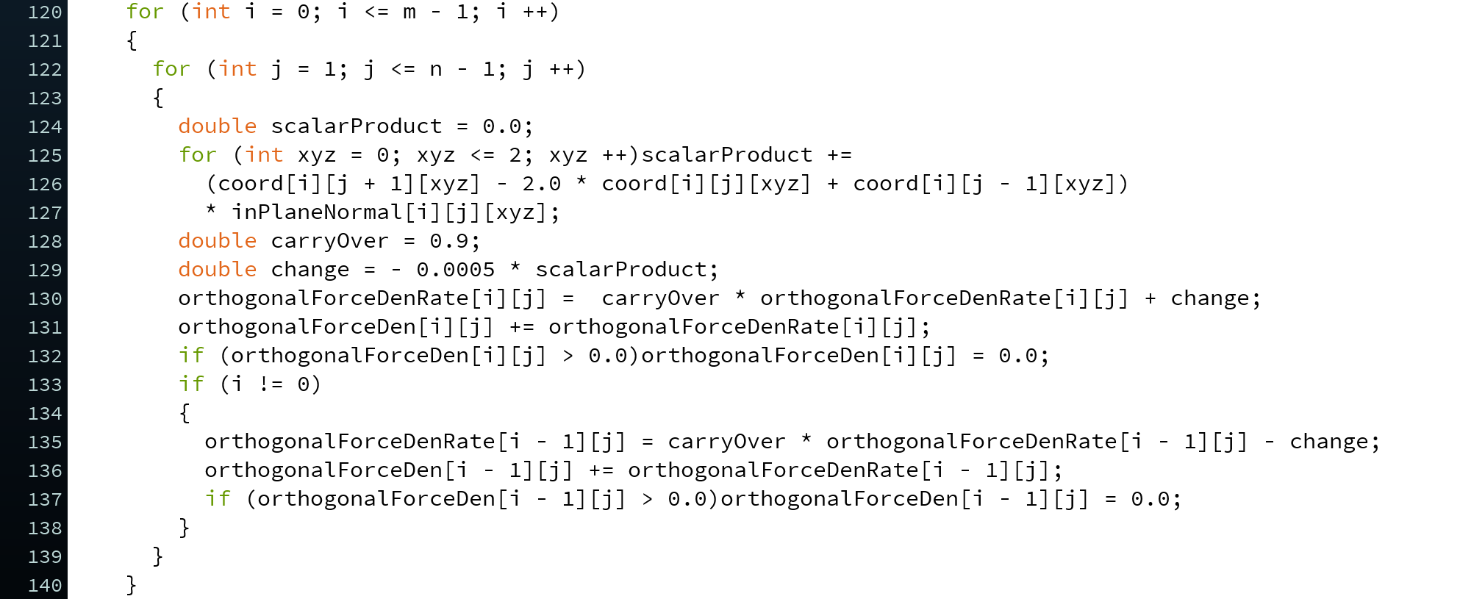
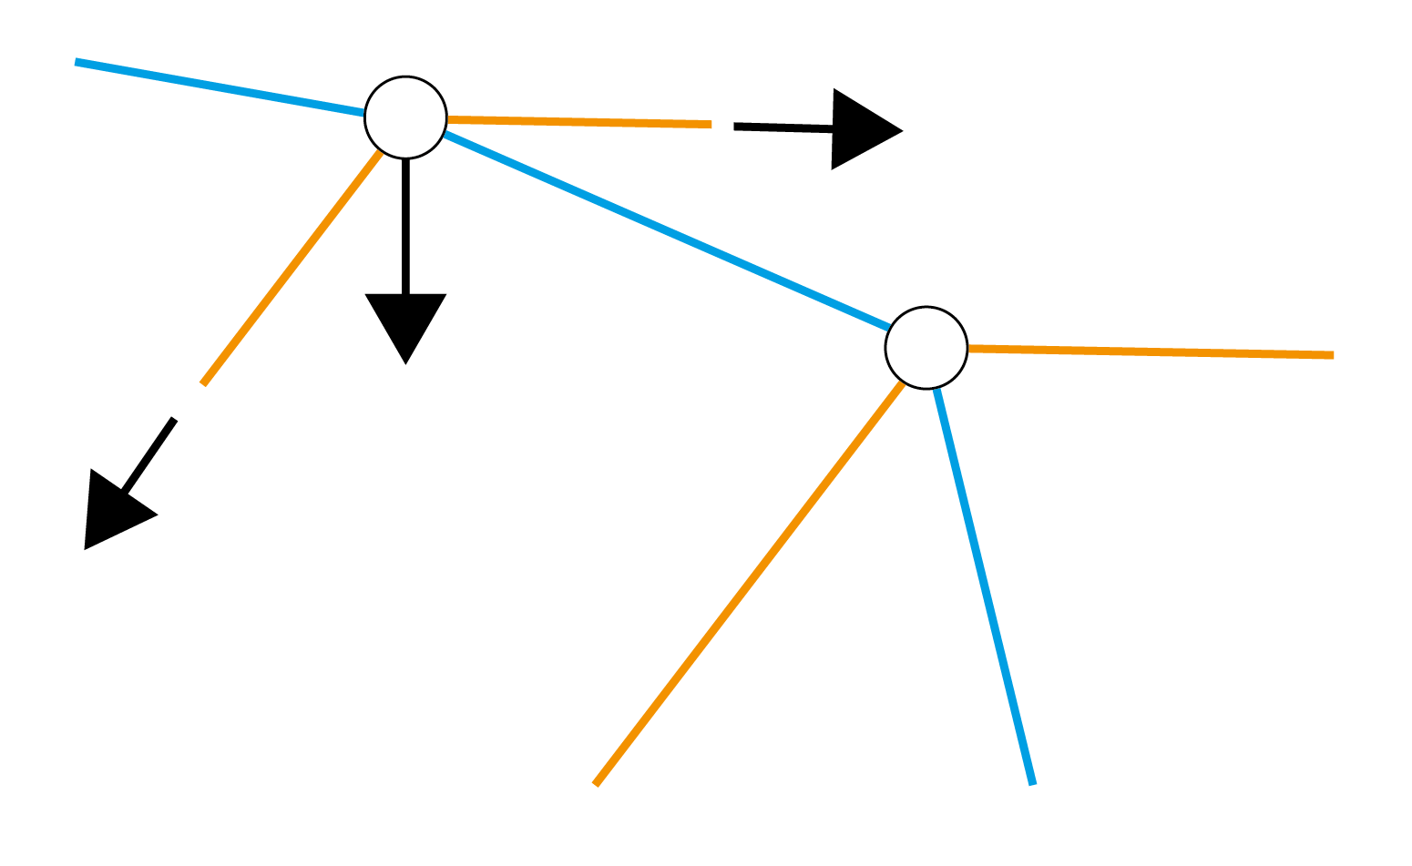
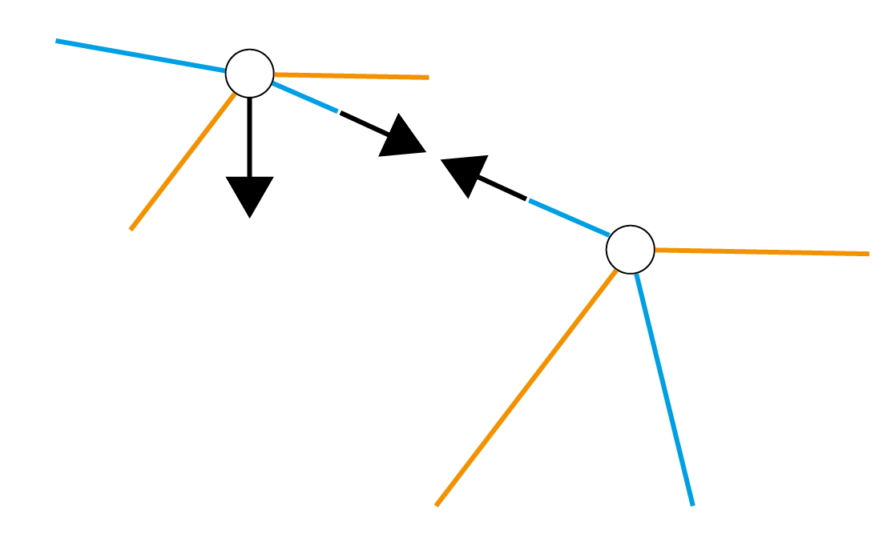
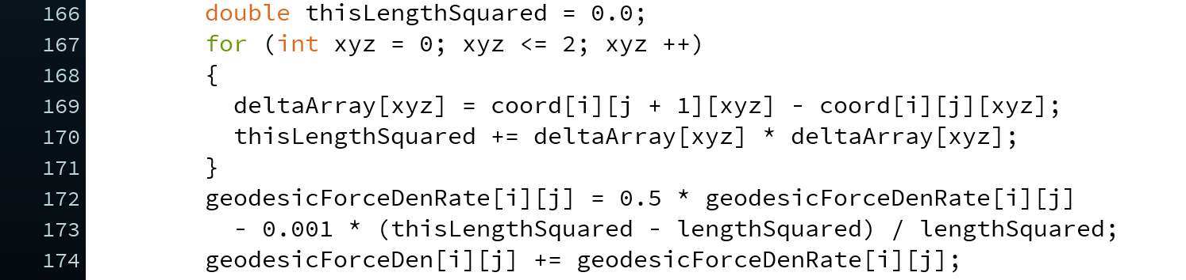
Adjust force density to make geodesics
Adjust force density to preserve constant spacing along geodesics
Solve equilibrium through dynamic relaxation
Notes:
We use force density to control the behavior, firstly we adjust to make the geodesics, secondly adjust to get the constant spacing. And then we transfer into a dynamic relaxation problem and solve the equilibrium.
Selected piece of code to explain how it works.

Slide 20
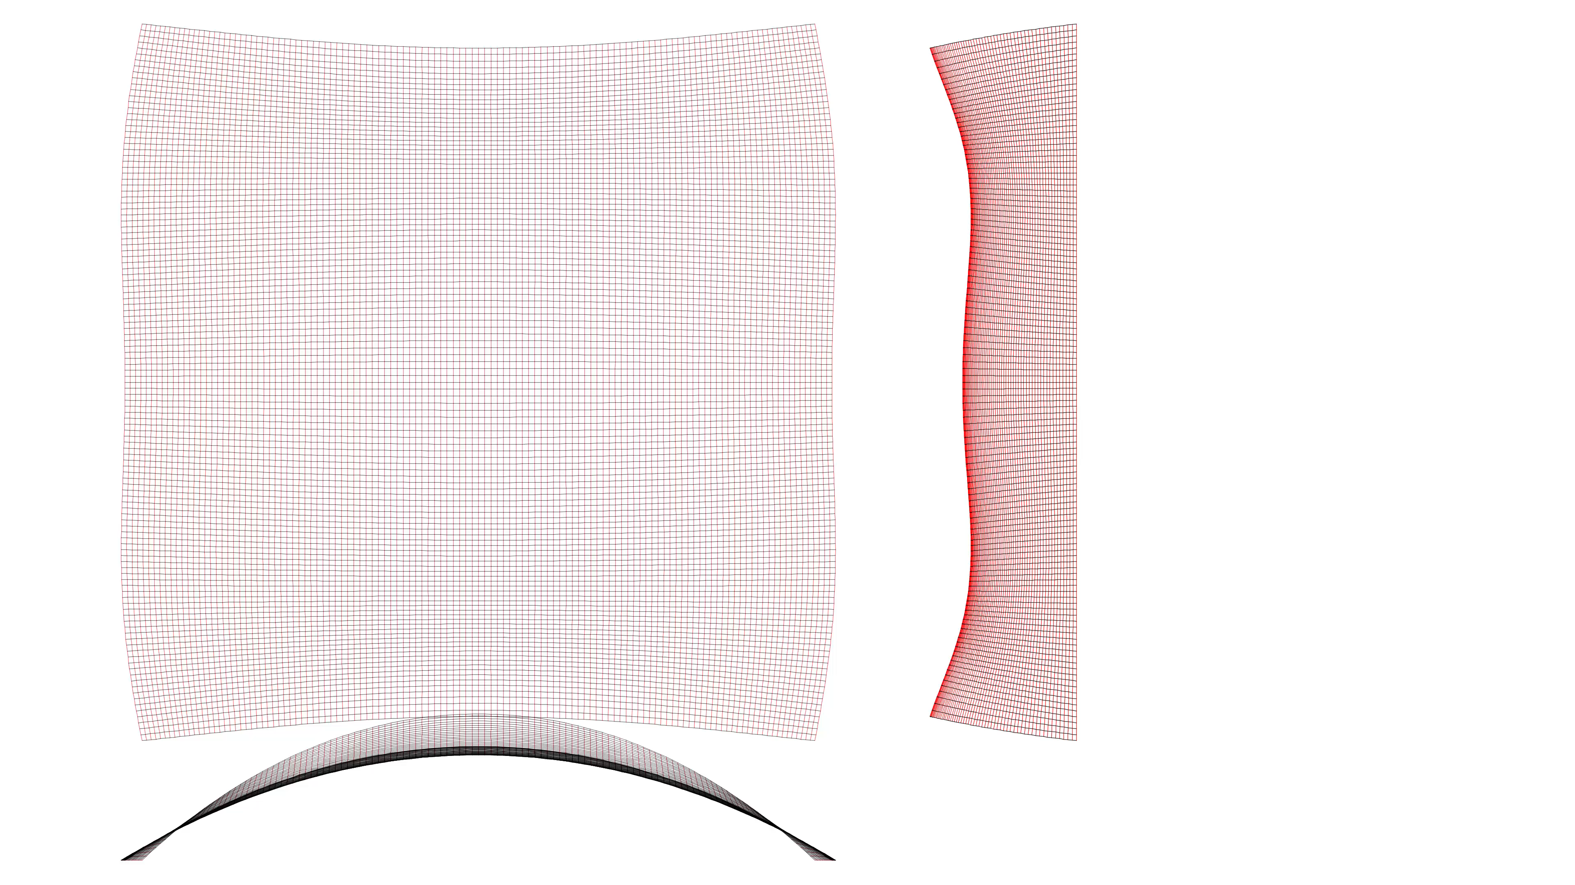
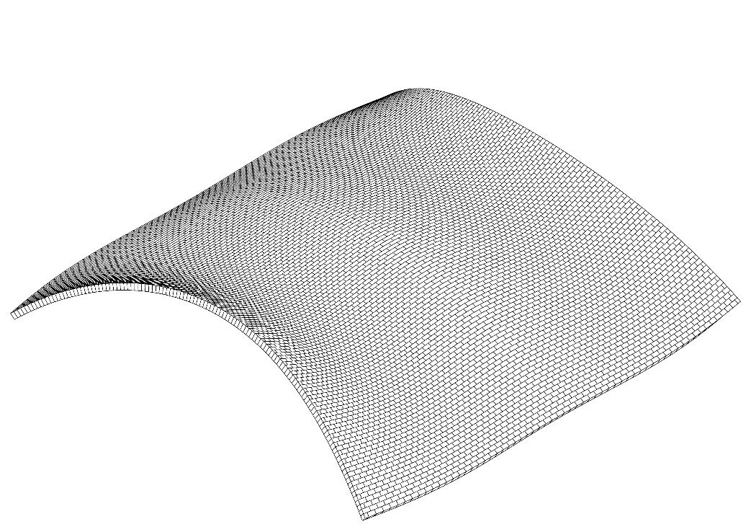
Equilibrium reached
Our form finding procedure in action
Notes:
Here is the program running and the great thing is that now the pattern also follows the stress distributions. You can find the code in our paper and run it yourselfs.

Slide 21


Decorating technique - geometrical mapping on known shell
Form finding - generate form and pattern simultaneously
Thanks to:
Mats Ander, Chris J K Williams
Notes:
We have showed how you can take a geometrical approach from the past and take the view of a modern designer with modern tools, and developed two methods with common concept. I would like to thank Mats and Chris for making this work possible and thank you for listening.

